Slide 1

ADA ON HOTEL BOKINGS
Presented By :- Mahammadumar
Guide by:- Pro. Abishek Wavhal

Slide 2
Summary of project
This Project is upon Analysis of Hotel Booking.
The Overview of this project is Explore and analyze the data to Discover important factors that govern the bookings.
In this Project We are Analyzing ,Cleaning And Visualizing the data and Create a Dashboard of this data.
The Given Data is a Large amount of data so First of All We are Remove Errors, Duplicate Values and Cleaning Data.
After That We are Analyze the Data and Finding a Null Values and Data types error then Remove it.
Then We are Inserting a New Rows & Column and define a Primary key.
Then We are Visualizing a Data And Find a Solutions of the Data
At last We Are Create a Dashboard Using the Visualization of Chart

Slide 3
Effect of Project
This Project is upon Analysis of Hotel Booking.
The Overview of this project is Explore and analyze the data to Discover important factors that govern the bookings.
In this Project We are Analyzing ,Cleaning And Visualizing the data and Create a Dashboard of this data.
The Given Data is a Large amount of data so First of All We are Remove Errors, Duplicate Values and Cleaning Data.
After That We are Analyze the Data and Finding a Null Values and Data types error then Remove it.
Then We are Inserting a New Rows & Column and define a Primary key.
Then We are Visualizing a Data And Find a Solutions of the Data
At last We Are Create a Dashboard Using the Visualization of Chart

Slide 4
Information of the Data
Hotel - Type of hotel(Resort or City).
is_canceld - If there was booking cancel(0) or not(1).lead time - The number of days between time books their room to arrive hotel.
arrival_date_year - Year of arrival date.
arrival_date_month - Month of arrival date.
arrival_date_week_number - Week no. of year for arrival date.
stays_in_weekend_nights - No. of weekend nights(Saturday or sunday) spend by guest at hotel.
stays_in_week_nights -No. of weeknight( Mon to Fri) spend by guest at hotel.
adults - No. of adults among guest.
children - No. of children among guest.
babies - No. of babies among guest.meal - Type of meal booked by guest.
country - Country of guest.
market_segment - grouping into categories based on their booking patterns and travel habits.
distribution_channel - Name of booking distribution channel.
is_repeated_guest - If the booking was from repeated by guest(1) or not(0).

Slide 5
previous_cancelletions - No. of previous booking that were cancelled by the customer prior to the customer booking.
previous_booking_not_canceled - No. of previous booking that were not cancelled by the customer prior to the customer booking.
reserved_room_type - Code of room type reserved.
assigned_room_type - code of room type reserved.
booking_changes - No. of changes made to the booking.
deposit_type - Type of the deposit made by the guest.
agent - Id of the agent who made the booking.
company - Id of the company that made the booking.
days_in_waiting_list - No. of days the booking on the waiting list.
customer_type - Type of customer, assuming one of four categories.
adr - (Average Daily Rate) dividing the sum of lodgging transaction by the total number of staying night.
required_car_parking_spaces - No. of car parking spaces required by the customer.
total_of_special_request - No. of special request made by the customer.
reservation_request - Reservation status
reservation_request_date - Date of last reservation status updated.

Slide 6
Data cleaning summary
Remove the column name of company.
Replace value from agent column NULL – Other.
Then after remove the errors from all table.
Then remove the duplicate value from all table.
Then after add column total people(adult+children+baby).
Change data type of date/month/year.
Add column date(year&”-”&month&”-”&date).
Then after remove the all remove the column name (year/month/date/week).

Slide 7
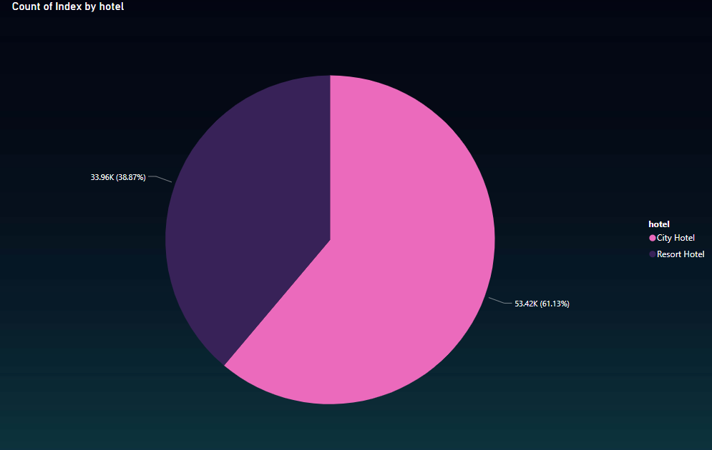
I used the pie chart to check and understand the hotel type is city and resort hotel of visualizing. Based this chart , 61.07% preferred city hotel and 38.87% preferred resort hotel. Which means city hotel more boking.

Slide 8
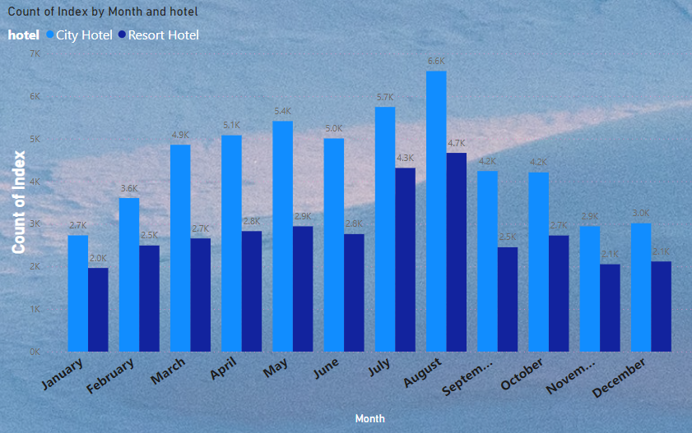
I used column chart because of many column in this data and I simply understand month wise count of people visualize.
On observation this chart I found maximum
People like city hotel because of more service and near good shoping mall etc.
Maximum people arrival in august.
6.6k people arrive in city hotel and 4.7k people arrive in resort hotel.

Slide 9
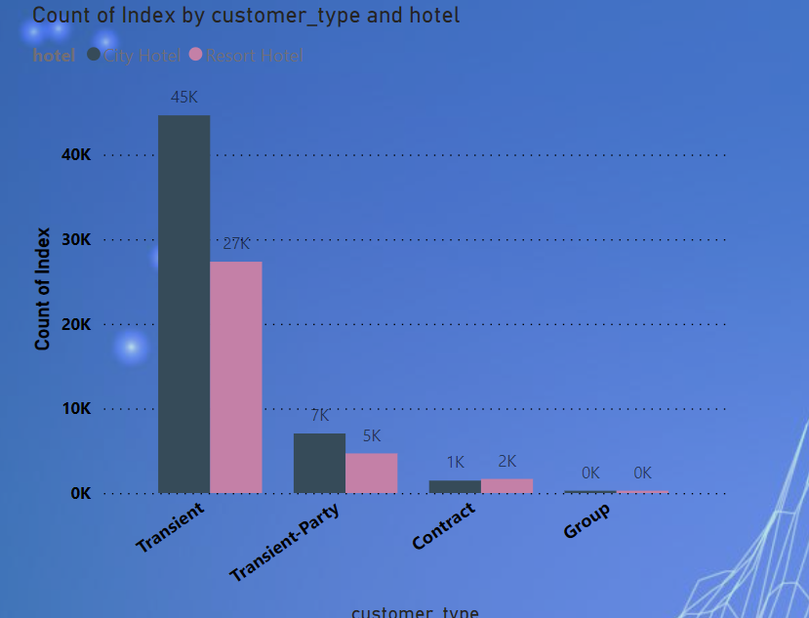
I used column chart because of simply visualize
And easily understand in this charts.
Based this charts most people arrive the transient. 45k people arrive in city hotel more than resort hotel.
Because of city hotel good facilities and better than service resort hotel.
Resort hotel incress good facilities and service
Then incress the profit.

Slide 10
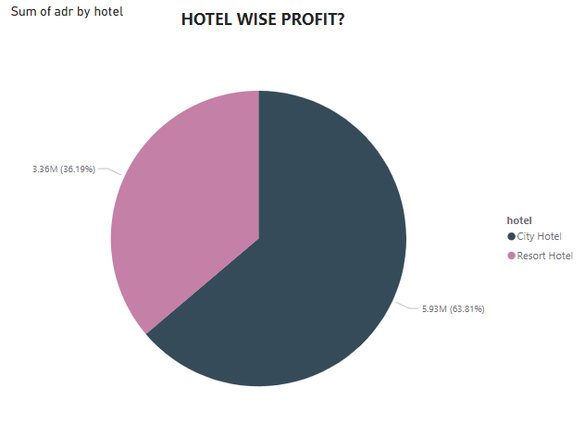
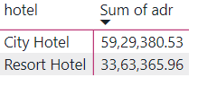
I used the pie chart to check and understand the hotel wise profit is city and resort hotel.
City hotel profit higher than resort hotel.
City hotel profit 5929380.53 and resort hotel profit
3363365.96.
City hotel more profit because of good facilities,
Service and good location city hotel.

Slide 11
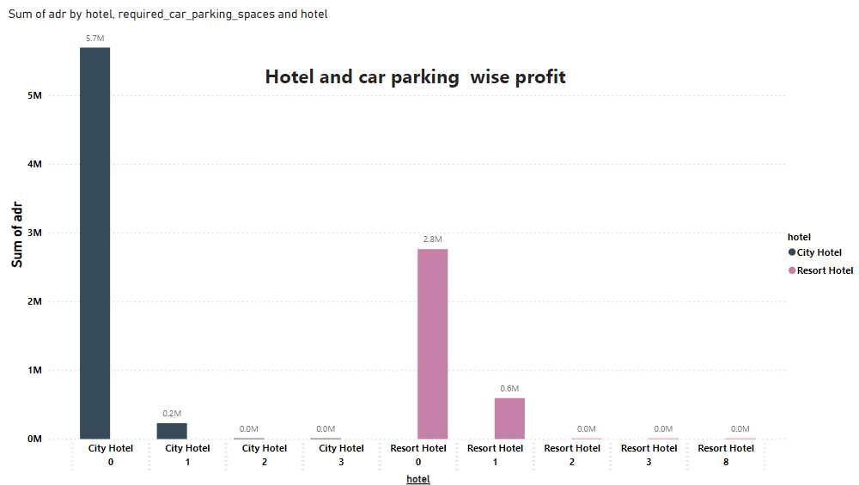
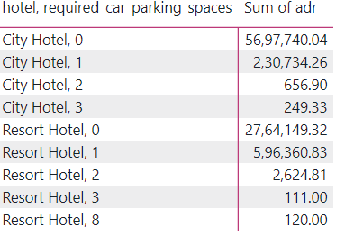
I used column charts to check and easily understand car praking wise and hotel profit.
I can see the both hotel charts, 0 car parking city hotel profit 5697740.04 and resort hotel profit 2764149.32.
Based on my observation no need car parking in both of hotel because of 0 parking facilities more profit.
But incress facilities and service.

Slide 12
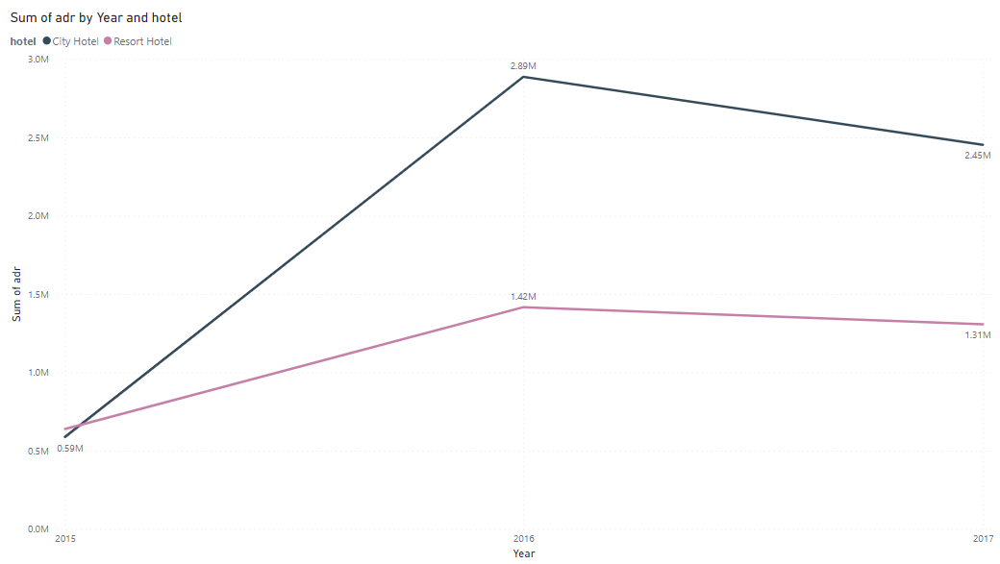
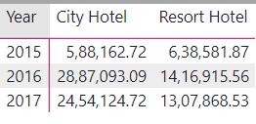
I used line chart to check and easily understand year wise profit.
I can see the data 2016 highest profit in both hotel.
2016 City hotel profit 2887093.09 and resort hotel profit
1416915.56
City hotel more profit compare the resort hotel.
Resort hotel in 2015 good profit more than city hotel.
After 2015 compare the resort hotel good profit in city hotel.
Because of good facilities , service and good location.

Slide 13
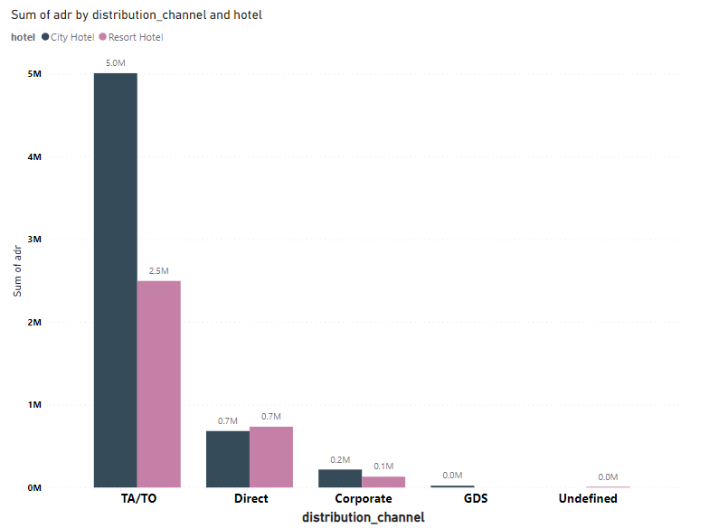
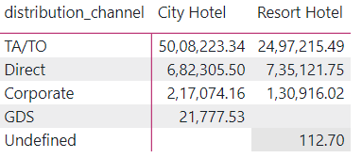
I used column chart to check and easily understand channel wise profit.
Based on this charts TA/TO distribution channel good boking in hotel.
TA/TO distribution channel good profit in city hotel and resort hotel but direct boking decress the profit and boking compare the TA/TO.
Direct boking incree then not pay commission and other channel boking then you pay the commission.
Then incress the direct more than more boking then effect direct in profit because of you not pay commission in direct boking.

Slide 14
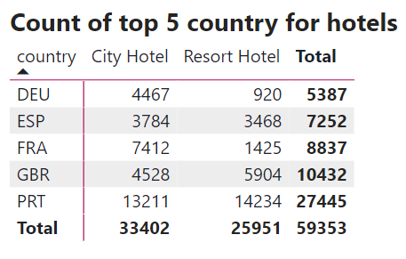
I used the Table To check and understand the top 5 country people is preferred hotel for stay.
Based on the above observation, I found something portugual country is top 1 country boking hotel.

Slide 15
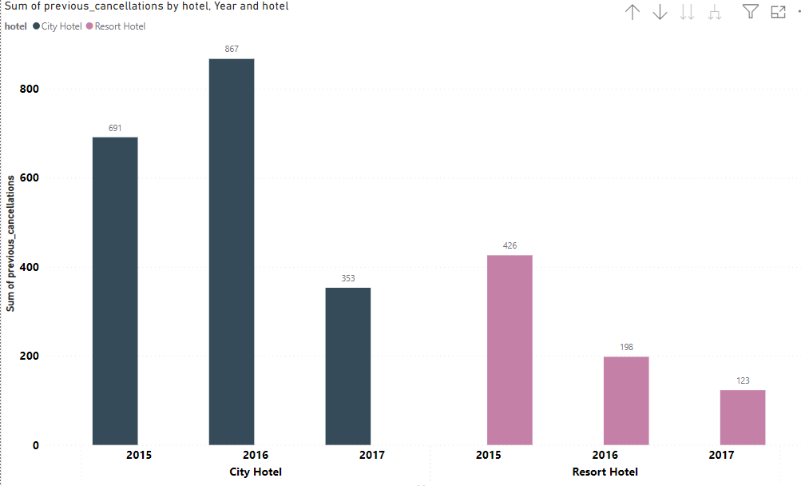
I used column charts to check and easiely understand year wise previous cancellations.
Based on my observation city hotel cancellation
more than resort hotel.
In city hotel highest cancellation year of 2016.

Slide 16
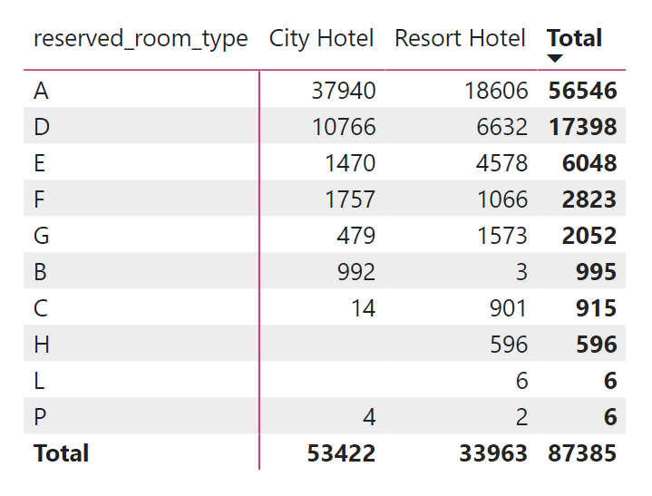

Slide 17
Solution to Business
Solution of The Project if Resort Hotel Increase his Business then It has Develop More Facilities And Provided many Amenities to Attract to the people .
Amenities And Facilities like Parking facilities , Multi types of Dinner and Lunch Facilities , etc...
And Last And Most Important Thigs To Know About Customers Interesting Activities .

Slide 18
conclusion
Conclusion Of the Whole Project 61.13% People Preferred A city hotel for stay because of multiple Reason.
And 38.87% people Preferred Resort Hotel because of lake of Facility and this hotel is far away from City so in holidays seasons customers this hotel.

Slide 19

Any Quations !

